Slide 1

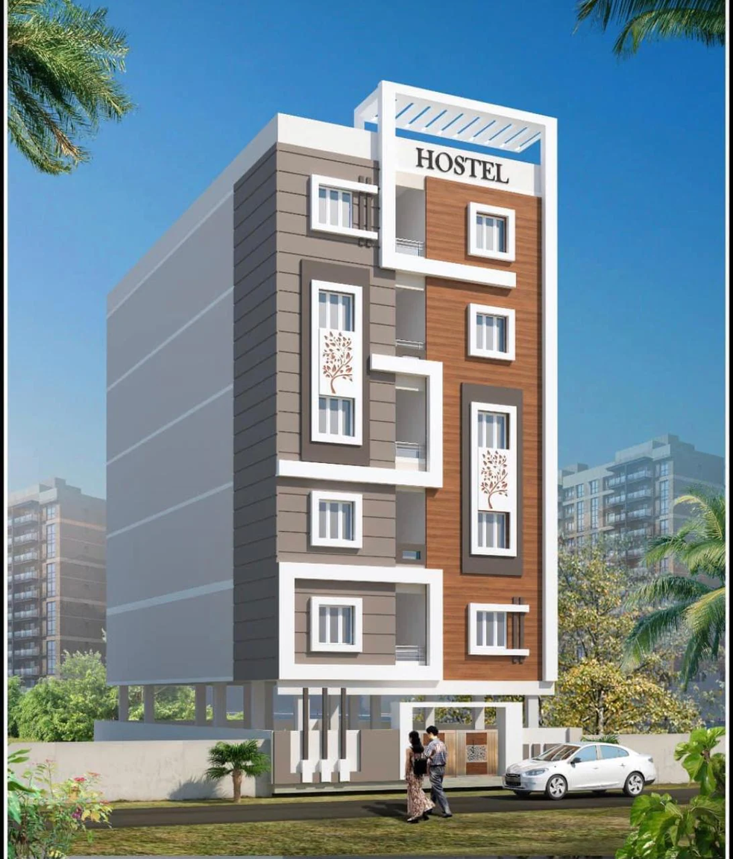

Towards Digital Hostel Administration: A Modular Web Application Approach
POOJA S D - 2SD22CS130
AMBIKA T C -2SD23CS400
PUNARVASU S - 2SD23CS407
SMITAL S K - 2SD23CS409

Slide 2
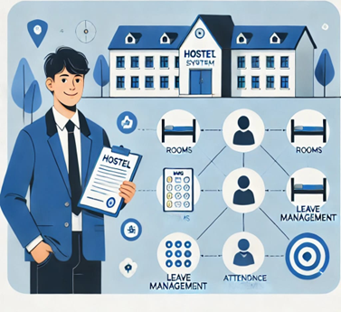
Introduction
A Hostel Management System is a web solution that automates hostel operations like room allocation, attendance tracking and leave requests, ensuring seamless management with minimal effort. The system enhances communication between hostel staff and residents, improves operational efficiency, reduces manual errors and provides real-time updates. The system is intended to simplify and computerize daily hostel activities while improving user friendliness, connectivity, security, and reliability compared to a manual system.

Slide 3





OBJECTIVES
01
To Enable students to apply for and manage leave requests seamlessly.
To Implement attendance tracking system that captures student attendance.
02
To Automate the process of allocating rooms to students based on various criteria, such as preferences, gender, and room availability.
03
To Generate reports for the various metrics. To provide timely and efficient notifications for improved communication.
04
05
Handles student complaints and ensures timely resolution by hostel staff.

Slide 4
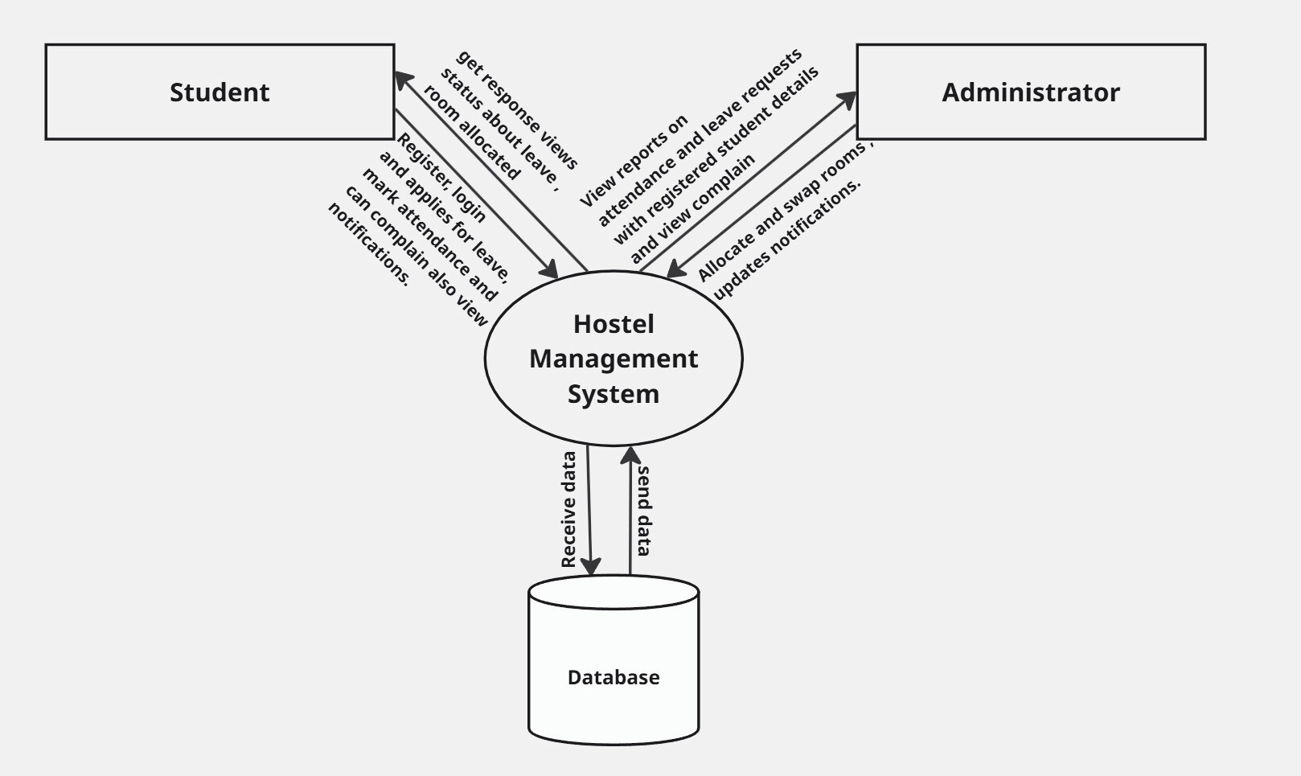
SYSTEM ARCHITECTURE

Slide 5


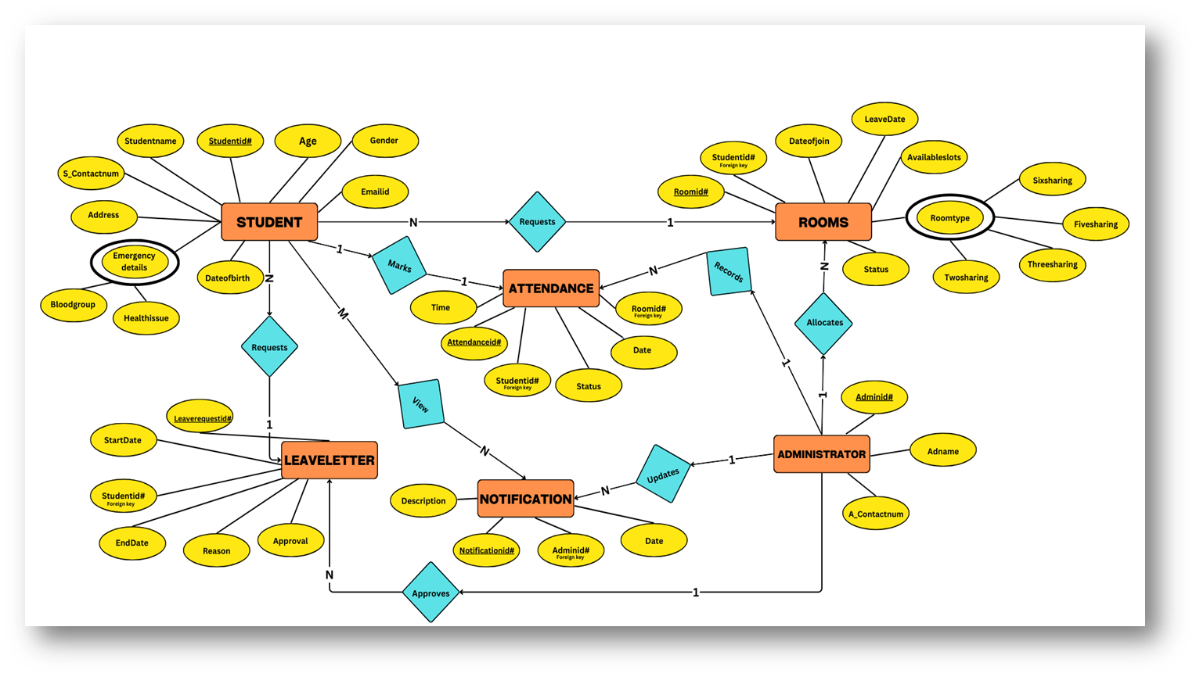
ENTITY - RELATIONAL MODEL

Slide 6


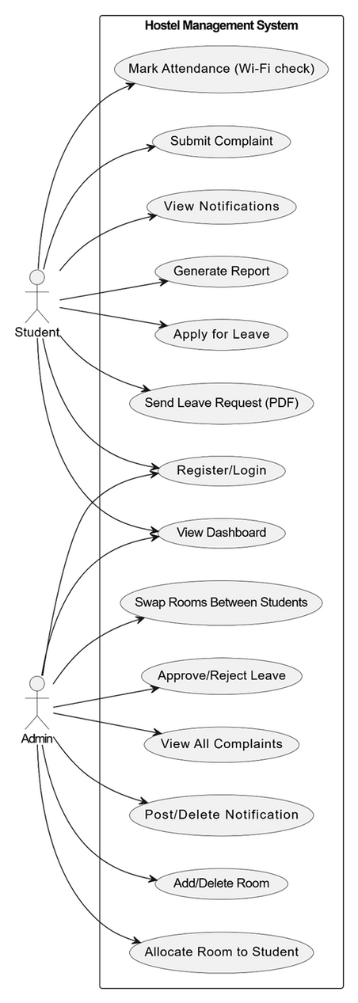
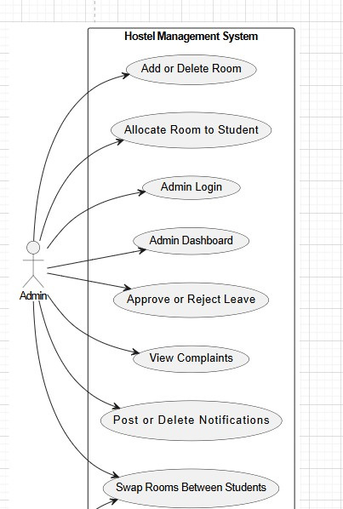
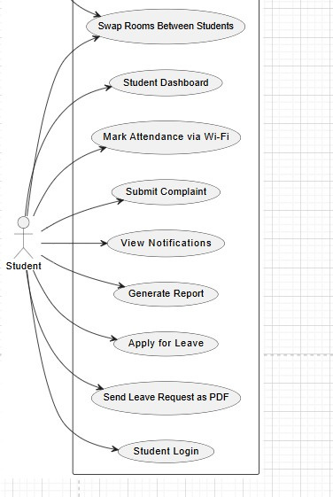
Use - Case

Slide 7

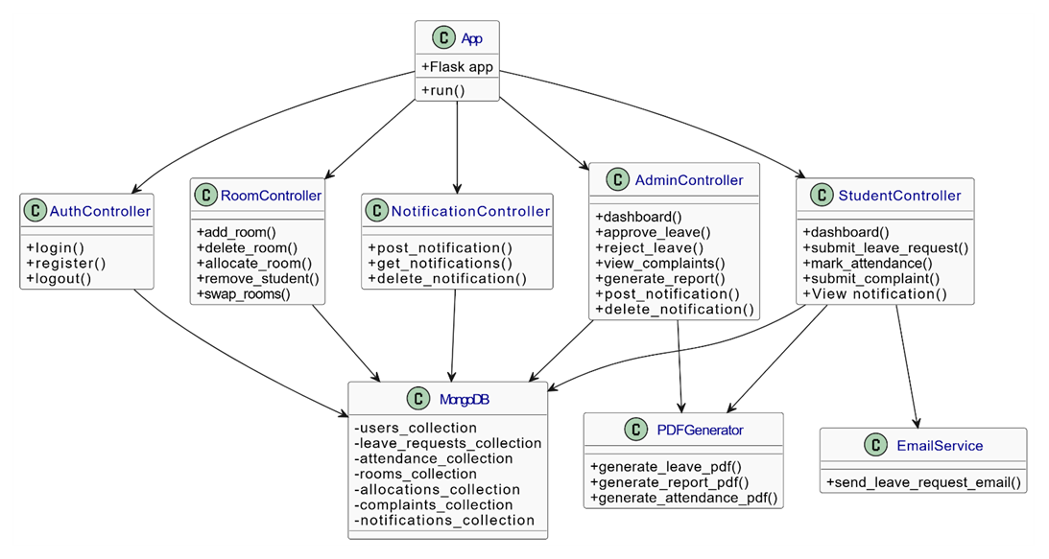
CLASS DIAGRAM

Slide 8

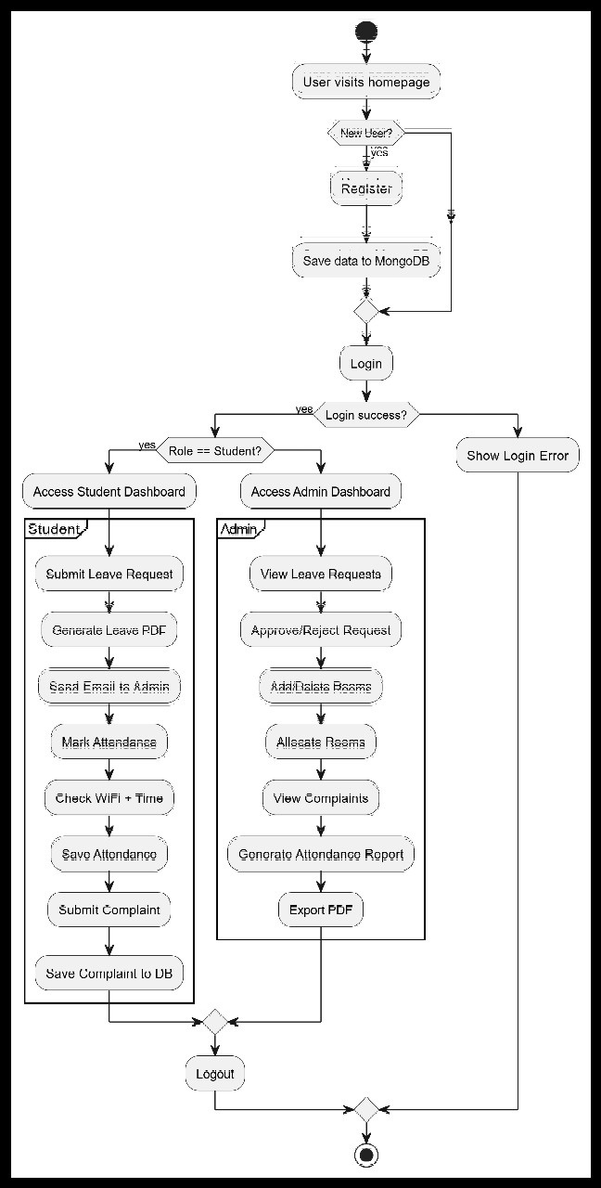

Activity Diagram

Slide 9
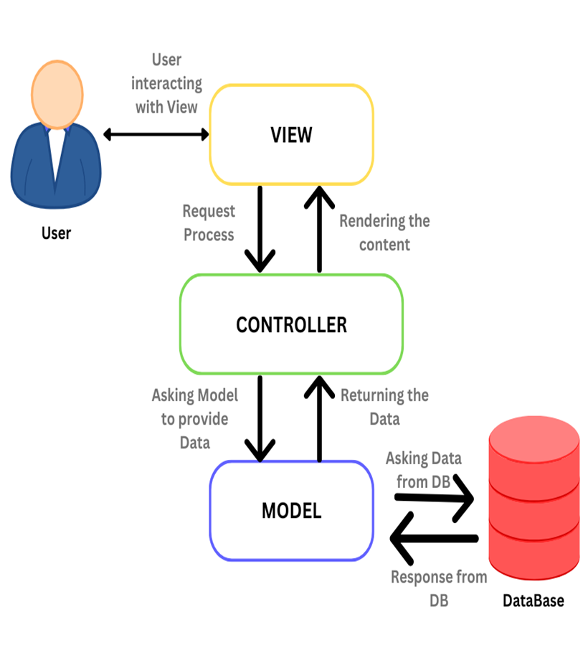
MVC Pattern
1. Model:
Handles database interactions and defines data structures (e.g., Student, Room, LeaveRequest entities).
2. View:
Manages the user interface, rendering web pages and forms to display data to users.
3. Controller:
Acts as a bridge between Model and View, processes user inputs, executes business logic, and delivers data to the View.

Slide 10


Conclusion
01
A web-based system that streamlines room allocation, attendance, leave requests, complaints, and notifications, eliminating manual inefficiencies.
02
Built with contemporary web technologies and MongoDB, ensuring scalability, reliability, and ease of use with strong security features like authentication and encryption.
03
Real-time notifications and a modular interface improve transparency and responsiveness between students and administrators.
04
By automating routine processes, the system minimizes human errors, accelerates task completion, and ensures accurate data management across all modules.

Slide 11
THANK YOU

